Slide 1

How to Create Kubernetes Experts
Notes:
(AARON) Hello everyone. My name is Aaron, and welcome to “How to Create Kubernetes Experts”. Before I begin, I would like to ask a few questions of the audience: 1. By a show of hands, how many of you are already K8s experts?
2. Alright. How many of you are still on your way to becoming experts?
3. Now, how many out here are having trouble acquiring K8s expertise in your company?

Slide 2


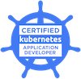
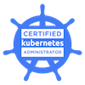

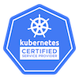
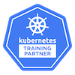
Who Are We?
Clarke Kubernetes Educator
“Do we have to have a quote?”
Aaron Software Engineer
“Breaking things is a great way to learn about them.”
Notes:
Aaron (Aaron)
My name is Aaron Teague. I started here a little over a year ago. Before that, I was doing Technical Support and game programming in my free time. I was hired in with no knowledge regarding containers or Kubernetes, but with some grit and fantastic mentorship, I was able to achieve my CKA in about 7 months. I’ve been able to tackle some big projects like changing storage backends, to upgrading a cluster from 1.5 to 1.13, all without customer downtime.
Clarke (Clarke)
Kubernetes Educator
Primary training author (~100 modules)
Now a CKAD & CKA
Started making training
Now company is KTP
Final note:
We felt pain of being new ourselves
And not having enough experts in company to help

Slide 3
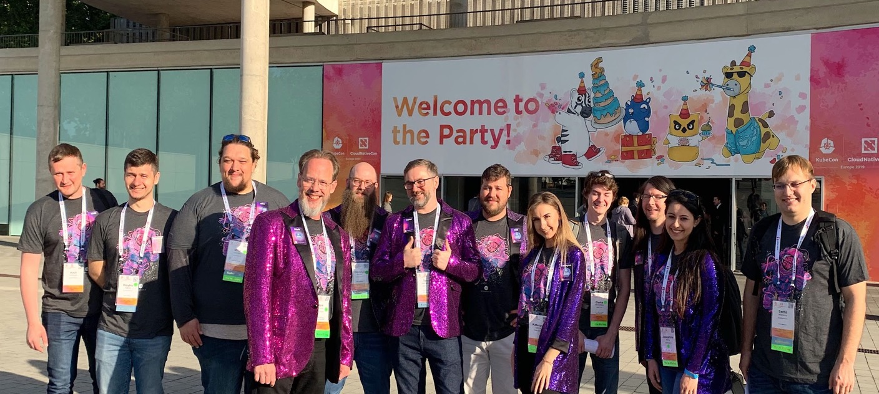
Who Is Supergiant?
Notes:
Who are we? Supergiant provides support, training, and consultation as a K8s Certified Service Provider and a Kubernetes Training Partner. We get to be the group of expertise that others seek out when they themselves are looking to get into this crazy, container orchestrated world we live in now. And we want others to know and embrace the Kube lifestyle.

Slide 4
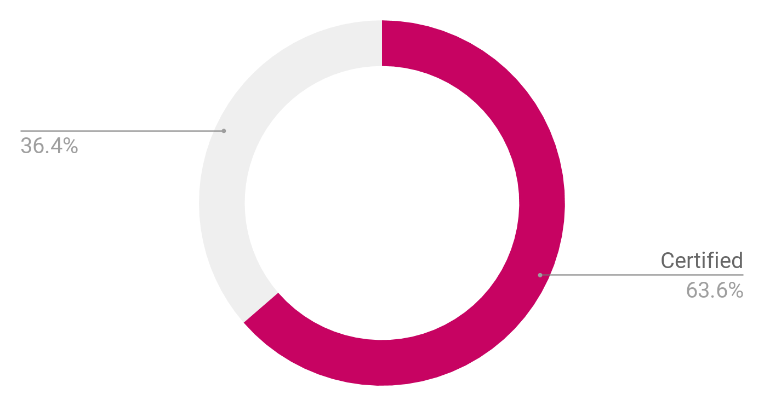

63% Certified
Notes:
We have an office in the United States and another in Europe. In the last year and a half, we’ve brought up more certified K8s experts than any year prior, from entry level support techs to CKA. As of last week, between our two offices, 63% of our engineering staff is certified and we plan to raise that percent even higher during this year. And the goal of this talk, is to pass along our tips and tricks so that you can do it too.

Slide 5

Agenda
How to Create K8s Experts:
Why build experts?
How do you build experts?
Conclusion/Resources
Notes:
We travel around the world training people, but we foster a culture of learning in our own company.
In the end, this talk is for you that raised your hand to the “Looking for K8s expertise” question from earlier. For everyone else, I think you’ll still find some value in this presentation.
So why should you pursue expertise by building it in house? Why is this a good option?

Slide 6
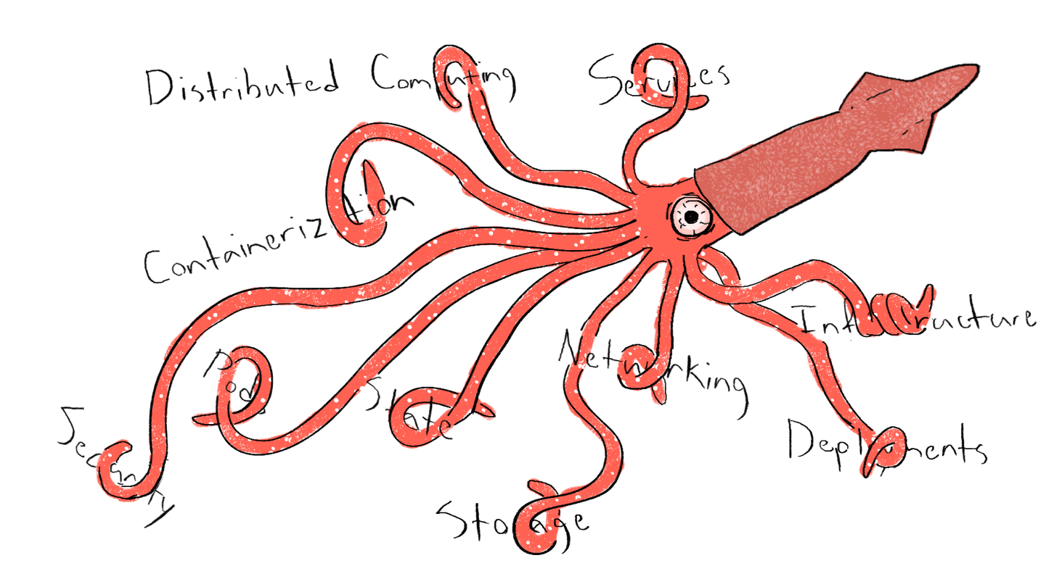
Notes:
The way you tackle the K8s kraken is unique to you.
The tools you use, the platforms you use, are unique to you.
Even if you hire an expert prequalified for K8s, they still need time to learn your fighting style.
In our experience, it takes almost just as much time to teach a pre-qualified expert how we use our tools as it does to train someone who has never used them.
Experts have deep roots you have to rearrange or sometimes even rip out.
Trainees are blank slates. You have to just teach, instead of reteach.
Trainee that is brought up in your company has a natural skill for solving your specific problems.

Slide 7

Margin of Error
Less room for mistakes when hiring qualified experts
Higher risk & time crunch:
less time to make ROI!
Entry-Level hires cost less
Easier to make return when investment is lower
Notes:
Time period you spend training a newbie is much less costly than normalizing an expert.
Less room for mistakes when hiring a direct expert.
You need to make a Return on Investment faster when hiring experts.

Slide 8

Creating Experts Fosters Bonds
Creating Experts Fosters Bonds
Bonding reduces turnover
A bond to the company
Company is investing in careers & growth
Employee sees their impact scale with growth
A bond to other employees
Employees grow together
Notes:
There are even more benefits for creating experts in house.
Creating experts bond between company and new hire.
Company is investing in their career.
New hire is seeing their impact over time.
New hire is gaining new roles over time.
Builds bonds between employees.
They grow together!
And bonds reduce turnover!

Slide 9

Last, But Not Least
Hiring newbies creates a culture of opportunity
Opening doors for less experienced, educated, or privileged individuals
You’ll be amazed at how people can grow!
Notes:
There are also other important non-financial benefits.
Hiring newbies provides opportunities for less educated or experienced individuals.
These individuals are more passionate for growth but may not always get opportunities.
You’ll be surprised at how many people are out there who can become K8s experts!
It’s just all about getting the right types of people.
We’ll explain this later.
Clarke’s story: couldn’t find a tech-related job anywhere.
Applied all around the world and got 1 interview. Guess what company?

Slide 10
Ok, so creating experts is great. But isn’t this an unreasonably difficult task?
Notes:
Ok, cool, so creating experts is great. But isn’t this really hard to do?

Slide 11

Anyone Can Create an Expert
Notes:
Nope! And what if I told you that we’ve hired newbies for 40,000 - 60,000 a year and then made them experts? This is possible as long as you foster the educational and mentoring community in your company. With the right hiring and filtering, you can hire someone off the streets and make them K8s worthy. We know this because we’ve done this. Both Clarke and myself have received our CKAs at around the ½-year mark since working at Qbox. And as a bonus, as your ability to lead and mentor improves, the time it takes for someone to go from new-hire to expert decreases.

Slide 12
Agenda
How to Create K8s Experts:
Why build experts?
How do you build experts?
Conclusion/Resources
Notes:
The goal is to hire someone new with lesser experience and create an expert.
So how do you do that in house?

Slide 13

The Big Picture
Notes:
Let’s walk through the big picture.

Slide 14

Our Various Teams
Hosted Elasticsearch Support
Hosted Elasticsearch Development
Kubernetes Training
Supergiant Toolkit Development
Marketing/Sales
Notes:
Every company has various teams or departments that make up a company as a whole. For example, ours has hosted elasticsearch support, hosted elasticsearch development, kubernetes training, Toolkit Development, marketing and sales, and several others.
Every company has various teams or departments.
For example, we have a Hosted ES Support team, a Hosted ES Development team (what Aaron is on) or a Kubernetes Training team (what Clarke is on). There’s also sales teams, marketing teams, and several others.

Slide 15

Jobs & Roles
Each role fills a function of a team
Roles don’t require clear boundaries
Allows employees to pursue interests, often leading to powerful results
Notes:
Each team or department has various roles.
Each role fulfills various functions on a specific team
For example: junior developers and senior developers. Frontend and backend flavors of both of these, which cater to different skills and requirements.
Roles don’t have to have clear boundaries. If someone seems interested in something outside their dedicated role, throw them a task regarding it. They may surprise you.
In agile methodology, people mix and mingle their tasks and communication.

Slide 16

Going From A to B
New hire starts at the entry role, “Point A”
Guide towards new roles and titles, to “Point B”
Change roles until successful
Notes:
Our “to-be expert” would start in one of these roles, the “Entry Point,
Following that, would make their way to Destination,
Going from one role, to another, to another, leveling up each time,
Until they achieve the role you consider to be an expert at your style of K8s kraken-fighting

Slide 17
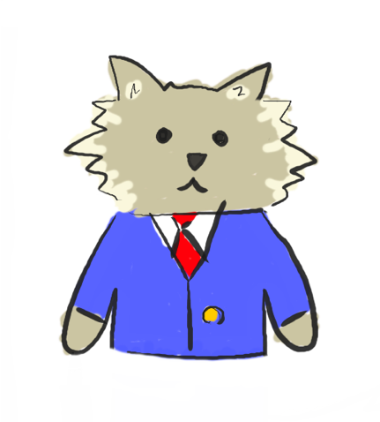
Step 1: Define the Destination
This is “Point B”
“We need K8s expertise here”
Understand your company’s goal and vision
Talk to people (managers, architects, etc.)
Notes:
Step 1: Define the destination. Your ultimate goal.
This is the Entry Point which you would say, “I have a K8s expert now.”
You need to have a good grasp on the teams and roles at your company to pick one as your destination.
To pick a good destination, you need to have a grasp on your company’s vision and goals
How they implement K8s to achieve that vision, in order to know which roles you need to fill.
Talk to your managers, leaders, etc.
What tools in the K8s ecosystem are you using?
How are you using them?
Those are questions you can ask.
These roles can be your goal.

Slide 18
Other Options
Could also be a cert.
Or team membership
Anything that fills your need
Your “destination” is just a flag to plant to say “we need help here.”
Notes:
Or, for example, a certification, like the CKAD is valid destination.
Could even be membership on a certain team.
Could be anything that signifies someone has filled your need.
And you can even have multiple Destinations!
Destination is just a flag to plant to say “we have a need for K8s expertise here.”
For us, the goal is having someone who can support K8s contracts and training, because that’s where we really need more help.
So our Destination is membership on any high-level role on either of our K8s teams, along with a certification.

Slide 19
Now?
Make that destination a worthy achievement!
More prestigious?
Good salary?
It’s the ultimate class!
Needs may change, so may trainee--ROI is most important
Notes:
Make that destination a worthy achievement.
Maybe destination role has a higher salary, better benefits, is more prestigious, gets to go on trips, etc.
This is kind of like the ultimate class in an RPG.
Note:
Your needs, and thus your Destination, may change over time.
Also, you may realize trainee is more exceptional with one role than another.
As long as you’re getting a ROI and fulfilling your need, that’s not bad!

Slide 20
Step 2: Define the Entry-Point
Destination target acquired, but what about Entry Point
A role that can start them towards B
Can be a junior dev or junior tech support
Multiple options for Entry Point and Destination
Notes:
Time for Step 2 in our plan. Define that Entry Point! Where should someone joining your company start out? What’s a good entry level position to take?
Pick something that loosely relates to the end goal. Is it a support position for a database? Does the database run as a service in Kubernetes? Perfect!
The position can even be something off the beaten path, like sells for services hosted in Kubernetes. It becomes easier to explain a service and advertise it when you understand and can pitch the underlying architecture.
In our company, that entry point is Hosted Elasticsearch support, which is managed by Kubernetes. That’s just our goto position, but there are many options depending on your company and roles.
Step 2: Define the starting point. Define Entry Point.
You have Destination, now where do people start?
What’s a good role for an entry level hire to take?
Pick something that will start them on their journey towards Destination.
Maybe it’s a junior developer role where they get basic exposure to K8s.
For us, it’s a junior Hosted ES support tech, who works on support tickets with a more experienced engineer.
Since our ES clusters run on K8s, they get a good starting dosage of exposure to K8s.
You can also have more than one Entry Point, like you can have multiple Destinations.

Slide 21
Point A -> Point B
Get someone from Entry Point to Execution
Progress achieved by moving through various roles
New Role = New Skill Requirements
Notes:
Now that you have an entry point and a destination, your goal is to bridge that gap, by progressing some individual from role to role. Each new role will require new skills to perform effectively. As time goes on, they will acquire these skills, getting them closer to the final end goal.
Now you have 1 or more Entry Points and 1 or more Destinations.
Your goal is to get someone from Entry Point to Destination.
Employees will do this by progressing from one role to another, to another.
Each role they take along the way will require new skills and contain new challenges.
As they go, they will acquire these skills, unlocking the ultimate role you want them to fill.
In this way, they will steadily level up to the ultimate role you want to fill.
(diagram of company roles, roles are labeled level 1, 2, 3, unlocked, 4, 5, 6 are locked, in distance is castle with crown over it, route is marked between diagram of company roles)

Slide 22
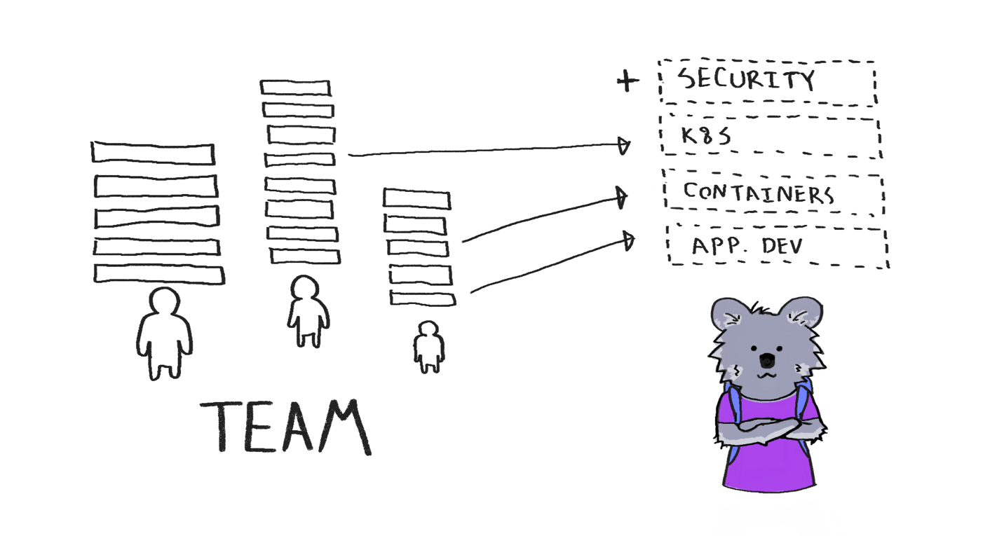
Notes:
Once that plan has been made, it’s time to look for someone to fill that initial role. It is time to put out a job posting. List out the skills that the role requires. How do you know which skills that role should have? Just look for other job postings for similar positions, copy what they do. Skills will be needed to master that role. Some will be mastered by doing daily tasks, projects, and other learning processes on company time or on their own.
Put up a job listing for your Entry Point position.
Figure out which skills that role requires.
How do you know which skills the role should have? Look for others in that role. What do they do? The trainee will need skills to master that role. Some of these skills will be gained by doing projects, others by taking daily tasks, others may be earned on their own time.
Then create a job listing with those skills.
For example, we start people as junior hosted ES support techs.
This requires some learning, it can be acquired in about a month on the job.

Slide 23

Step 3: Hire Someone!
The 3 Key Ingredients
Passion
no desire, no growth
Determination
face challenges despite hardship
Humility
Aware of possible growth
Notes:
Woot! Now that THAT’s out of the way, time to hire someone. But how do you pick the right candidate? There’s a few key ingredients to help sort them out.
First, they need to show some passion. If they don’t have a desire to grow, they will not.
2nd, determination. Challenges WILL come up, and without a lot of grit, growth won’t follow.
Last, humility. We all know that “know it all”. The one who has all the answers. “Supposedly” Seek for someone who is aware that they DO NOT have all the answers. Growth won’t happen when someone believes they’ve already fully grown. Step 3: Hire someone!
How do you pick the right candidates?
Trainee needs to be hungry to learn and grow.
Hire trainees with three ingredients:
Passion
If you don’t have a desire to grow, you’ll never try to... you won’t grow.
Determination
If you can’t face the challenges of growing, you’ll never overcome them... you won’t grow.
Humility
If you already think you’re great at something, you’ll never try to be greater… you won’t grow.
The people who raise the bar are those who never stop reaching for it.
Those who never stop reaching for the bar are those who never see themselves above it.

Slide 24
Skill is Good, Ability to Grow is Better
The ability and desire to learn outweighs impressive skills in the long run
Notes:
It can be really helpful if a candidate already has experiences with other skills you need, but there is no substitute for those three qualities mentioned. Like a video game, sometimes a good buff or multiplier outweighs a high-leveled skill in the long run, and that’s what you should be hiring for. The long run.
It can be really useful if candidates have experience with the other skills you need
But remember that there is no substitute for these three qualities!
Like in a video game, sometimes a good buff or multiplier outweighs a high-leveled skill in the long run.
Someone with a knack for learning will eventually outpace someone who already knows a lot but who isn’t passionate, determined, and humble.
(picture of candidates, including Stevie, with different skill bars above their heads? And Bork is looking contemplatively at the candidates, with a cursor over Stevie, who has a sparkling buff indicator for “determination?”)

Slide 25
Look For the Passion
Sources can include:
Colleagues
LinkedIn
Github
Check for the ability to self teach
Look for constructive hobbies
Notes:
But how do you test a job candidate for these traits? Well, you can check various sources like colleagues, linkedIn, and Github. Does the candidate appear to be taking on new challenges? Have they improved their skills in the last 6 months? Do they have some hobbies that they love that require some dedication? What about a portfolio that they take pride in and update?
Remember, it isn’t about their skill, but rather looking at their ability to learn and grow. To embrace new challenges. To have a basic understanding of technology, but a eagerness to push their understanding further.
How do you test for these candidate traits?
Check recent growth.
Is the candidate taking on new challenges?
Have they improved their skills in the last 6 months?
Do they have hobbies they love that require dedication?
Do they have any portfolio showing recent projects they’ve done that pushed their limits?
Remember, you aren’t hiring based on skill.
It isn’t about how cool the projects they’ve done are to you.
It’s all about pushing their personal limits.
Require at least have a basic understanding of applications and technology!
Programming projects are an indicator of this.
Find a good hire with lots of passion.
Passion can often be hard to spot, but there are some tell-tale signs. We often look for what a candidate knows, and not at their ability to grow. The points to see how well they can learn is to see how well they can teach themselves. This can be using LinkedIn profiles. This can be recommendations from colleagues. This can be done well using Github, to see what projects they’ve worked on. What programming languages did they use? Do they have a professional education experience using that language, using a college? Does it appear to be self taught? There isn’t a college that we know of that specializes in Kubernetes, so much experience is done using self taught means.
What about their hobbies? It it something for pure entertainment like movies and videogames? There’s nothing especially wrong with those hobbies, but if the hobbies are tinkering with mechanical projects, woodworking, crafting, those tend to imply a sense of learning and exploration.
Learn to target these people that show the ability to teach themselves and it will make your job much easier.

Slide 26
Be Transparent
Make candidate aware of their role (point A) and eventual goal (point B)
Don’t expect point B to be quickly achievable
If K8s expertise is needed NOW, don’t hire. Consult!
Notes:
Be sure when interviewing and hiring that you be up front. You’re hiring in for an entry position, but it’s going to take a lot of learning and be hard. Let them know that you will be pushing them towards certification and expertise. If you don’t and they show up on the first day with someone asking when they’ll get a CKA, it won’t lead to a very good work-employee relationship.
And don’t expect expertise right away. We’ve gotten the process down to less-than a year, and that is with a lot of trial and error. There’s even a chance that the person you’ve picked doesn’t ever make it. That’s the gamble we can take more easily by hiring for less and promoting as expertise is acquired. If you need an expert sooner than later, find a company that does consultation. It can cost a fair amount, but is often much more affordable than hiring and hoping. Especially if you need it quickly.
Misc. Notes:
Inform candidates that the goal is to grow them into new positions.
Lack of clarity for candidate isn’t just uncomfortable for them.
It’s unethical!
Candidates need to know what they are getting into.
Don’t expect to fill needs quickly.
We’ve gotten this process down to roughly a year, but that’s still a whole year.
People may not even turn out how you thought.
May end up in different role, may not be capable, may quit, etc.
If you have pressing needs, get a contract with someone.
Don’t hire newbies directly into your Destination.
Even if you hire, you still need these ingredients.
So get a contract.
Or, if you have time, build an expert!

Slide 27
Step 4: Begin the Quest!
Start by introducing the trainee to their initial role.
For example: our entry-level support techs handle tickets alongside senior engineers.
Notes:
Step 4: Begin your quest!
Start by getting the trainee introduced to their initial role.
For us, the first role is handling ES support tickets with a more experienced engineer.

Slide 28
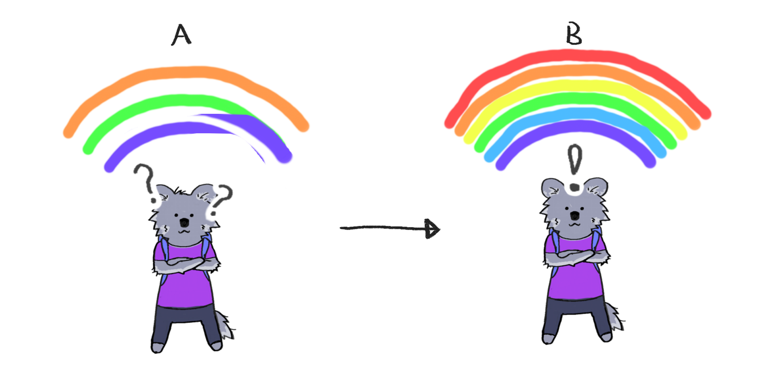
Notes:
Now.. those skills you determined earlier? Help the trainee get those skills!
Each of those skills constitutes a layer of capability they gain in order to master their role.
Like a full rainbow of colors, they become more complete!
As a trainee, you can tackle new unknown frontiers because everything is properly illuminated.
Once they master that role, they’ve completed their first milestone!
Then, they can move onto the next!
So the first milestone is: get them to that point.

Slide 29

Sidequests
Nudge along with various tasks to gain experience.
Sidequests can include:
Projects to take on
Finishing a training course
Participating in certain jobs
Notes:
How do you do that? How do you fill in those skills and move to the next milestone?
Give trainees “sidequests” to achieve that push them there.
Some tasks are like side quests that help you grind experience.
They help someone grow, but they don’t come with rewards.
Side quests can include:
Projects to take on
Finishing a training course
Participating in certain tasks

Slide 30
Sidequests
Tailor sidequests to fit between current skills and desired skills.
Maybe trainee can code
Maybe trainee needs to learn Docker
Containerize an app with Docker!

Slide 31
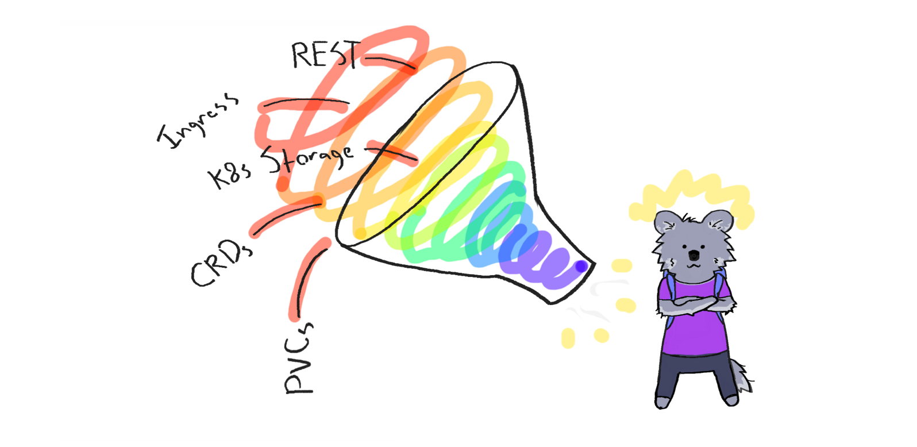
Notes:
Along the way, there may be topics they don’t understand.
Give them supplementary materials (courses, etc.) to help fill in these gaps.
These are the best side quests to use for knowledge gaps.
Make sure to also give trainees opportunities to apply that knowledge into meaningful projects.
The more the trainee feels like they are contributing to the company, the better!
Also, mentor the trainee, or find someone who can!
Sometimes, trainee will need to use free time to learn.

Slide 32
Growth and Reward
Milestones should challenge people
But also reward them
Example:
Getting a CKA cert.
Small monthly raise
Milestones should be frequent
3-6 months
Smaller, more frequent rewards are more effective
Money isn’t the only thing that matters
Notes:
Milestones should be challenging but rewarding.
For example, moving to the next role (like an on call support tech), completing a certain big project (like a K8s cluster upgrade) or passing a certain exam (like the CKAD exam).
For us, we give a small promotion when someone gets to be a self-sufficient on call engineer, $500 monthly bonus when someone gets K8s cert., etc.
Most people want to feel valuable, like their work is actually helping. Challenging rewards help with this.
Milestones should be relatively frequent.
Try to make milestones that people can achieve in around 3 months, 6 months at the longest.
For example, our ES junior support techs get on call by 3 months in, they begin development by 6 months in, and they generally get their CKA at 9 months in.
We find these frequent milestones and rewards to be more effective than ever-elusive, big promotions.
Money isn’t the only thing.
Just having people recognize your effort is really meaningful.
Having a top brass boss actually appreciate your effort and tell you.

Slide 33
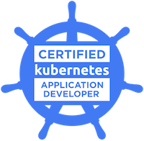
Eventually...
Your new hire won’t be new anymore.
They will master their role!
How do you know when their role has been mastered?
Ask yourself questions
Notes:
Eventually, your new hire won’t be new anymore.
They will master their current role and can move to a more advanced one.
For example, they can move from supporting your app to developing it.
When do you know when someone has mastered their role?
Questions you can ask yourself are:
Have any problems occured? Is there an indication of lack of understanding?
Is there a test the trainee can take that validates their skill level?
Can the trainee hold intelligent conversations with their high level colleagues?

Slide 34

A Flavor of Skill, Not Just a Flattering Title
Example: fixing a load balancer
Experience:
I can fix it, because I’ve memorized the process.
Expertise:
I can fix it, because I understand how it works.
Notes:
This is what you are looking for.
Let’s take load balancer repair, for example:
If you’re experienced, you can fix load balancers,
Because you have the company docs on them
Or you have done it a thousand times.
If you’re an expert, you can fix load balancers,
Because you know the ins and outs and concepts of networking, the concepts of infrastructure, etc.
This is similar to how our L1 and L2 support works at our company.
L2 techs don’t have access to special forbidden knowledge;
They understand the technology better
Enough to tackle problems that L1 techs can’t tackle.
Problems with no documentation
When you see this skill growing, you’re genuinely creating experts

Slide 35

When to Move to Next Role?
When the hire can sustain a ROI
When you can afford to
How to calculate ROI?
Maybe a # of tickets daily?
Cost savings for project?
Be honest and fair
Notes:
How do you know when it’s time to move someone up to a new role?
Generally, when they are able to provide a ROI.
In other words, when you aren’t losing money on them anymore, for their current role.
How do you know when someone has reached a ROI?
You need to be able to measure a role’s Entry Point which it has a ROI
Maybe it’s a certain number of support tickets or a direct impact of cost savings for a project, etc.
Be honest and don’t create unfair measurements.

Slide 36

Promotions
When to promote?
Up to you, each with pros/cons
Promoting “before”
Burden on company
Promoting “after”
Burden on employee
Notes:
When and how you promote to next role is up to you.
Each has pros/cons.
Could promote as soon as mastered previous role.
Puts burden on company to make trainee good at role as fast as possible
Could promote only when good at next role.
Puts burden on trainee to grow.

Slide 37

Rewards
Reward people
It’s possible for you
You do it when people are sustainable in role
It’s helpful to you
It amplifies passion!
It’s necessary for you
To avoid creating mercenaries
Notes:
When you move people up, reward them.
You can do this, because you don’t move someone until they’re sustainable in their previous role.
I.e., they produce enough revenue to cover their salary
You should do this, because it creates more hunger to climb the next rung.
If you don’t invest in people, they will eventually move on like a band of mercenaries
Your investment will mean nothing
That’s really on you. They will move on if you don’t provide the rewards or recognition you promised.

Slide 38
Summary
Start with initial role
Get up to speed on its required skills
Provide sidequests
Push limits and skills
Provide milestones
3-6 months
Provide rewards
Repeat the cycle
Document as you go
You have an expert!
Notes:
All in all, something like this:
Start trainee on initial role
Get them up to speed on required skills for that role
Provide sidequests for them, projects and tasks to do to continually stretch abilities.
Some milestones, too, which provide rewards
Promote them to new roles
Repeat the cycle of improvement
Until they become the expert you wanted!

Slide 39

Step 5: Rinse and Repeat
You’ve made it! You’ve guided someone from Point A to Point B! Now what?
Notes:
Congratulations! You’ve watched this individual move from a new-hire knowing very little to an expert capable of tackling all sorts of challenging projects. Moving them from role to role, learning new skills, achieving milestones. What do you do now?
Do it all over again!
Step 5: Rinse and repeat!
You just finished your first quest!
Now do it again!
For role in roles, learn skills, test knowledge, achieve milestones, move on to the next role, until Destination is reached!

Slide 40

Iteration
Iteration
Take notes for each time mentoring
Document the failures and successes. Form into a process
Tweak process after each iteration
Notes:
Iterate on this process. This may be your first time doing this, but you’ve learned and can do it again better. Take notes on went well and what didn’t, and use those going forward. Document this process and tweak it over each iteration. Over time, you’ll find that the journey from point A to point B, new-hire to expert, can be compressed with each iteration. You’ll eventually be able to get people certified with K8s relatively quickly. Iterate on this process.
This might be the first time you’re doing this.
Take notes on this each time you do it.
Document the process, learn how to improve it
Over time, you will compress the journey from Entry Point to Destination.
Like us, you will eventually be able to start getting people certified with K8s within a year of joining!

Slide 41

How We Do It
Start as Junior Elasticsearch Support Tech
Give projects from company backlog
Provide guidance along the way
Promote after milestones have been reached
Notes:
Internally, we’ve gotten this down to a science. Hire someone in as a junior Hosted Elasticsearch Support Tech, where they answer customer questions regarding their ES clusters, address downtime issues, receive requests for bug fixes or for features. After they get a bearing on their role, we kick it up a notch by giving them projects from our backlog. These can be changes for our website, implementation of the bug fixes or feature requests from customers, changes to internal processes, and more.
We provide guidance along the way. Some things are hard, and we try not to simply do the project for them, but rather give guidance on how they can find the answers.
After a while, promote up to new roles with new challenges, tackling more projects as they relate to K8s. After a while, have them take the CKA exam and provide a monetary incentive for passing.
Document, and do it again and again. For example, we have this process down to a science.
We start people as junior ES support tech.
They do …
And then …
We’ve documented this process thoroughly and have compressed this down to a year.
Which, if you think about it, is incredible!
That an inexperienced person can become an expert that fast.

Slide 42
Agenda
How to Create K8s Experts:
Why build experts?
How do you build experts?
Conclusion/Resources
Notes:
(Clarke) We compiled training supplements

Slide 43
Resources We Like
Courses:
katacoda.com/courses/docker
ryanstutorials.net/linuxtutorial/
kubernetesbyexample.com/
katacoda.com/courses/kubernetes
magicsandbox.io/
classroom.udacity.com/courses/ud615
edx.org/course/introduction-to-kubernetes
Notes:
Useful for supplementary training
We use them ourselves
Organized into categories
Skip through quickly, clarify:
No time to take pics
See these on our uploaded slides
On KubeCon schedule

Slide 44
Resources We Like
Courses (continued):
tutorialspoint.com/data_communication_computer_network/
khanacademy.org/computing/computer-science/internet-intro
Treasure Trove:
docs.google.com/spreadsheets/d/10NltoF_6y3mBwUzQ4bcQLQfCE1BWSgUDcJXy-Qp2JEU/
Videos:
https://www.youtube.com/playlist?list=PLvmPtYZtoXOENHJiAQc6HmV2jmuexKfrJ
Notes:
If you check out anything, see “Treasure Trove!”

Slide 45
Resources We Like
Videos (continued):
youtube.com/watch?v=8SvQqZNP6uo
Books:
shop.oreilly.com/product/0636920064947.do
shop.oreilly.com/product/0636920043874.do
Guides:
github.com/kelseyhightower/docker-kubernetes-tls-guide
github.com/kelseyhightower/intro-to-kubernetes-workshop
github.com/kelseyhightower/kubernetes-the-hard-way

Slide 46
Resources We Like
Guides (continued):
github.com/aws-samples/aws-workshop-for-kubernetes
github.com/hardening-kubernetes/from-scratch
deis.com/blog/2016/kubernetes-illustrated-guide/
Misc. Articles:
kamalmarhubi.com/blog/2015/08/27/what-even-is-a-kubelet/
kamalmarhubi.com/blog/2015/09/06/kubernetes-from-the-ground-up-the-api-server/
kamalmarhubi.com/blog/2015/11/17/kubernetes-from-the-ground-up-the-scheduler/

Slide 47
Resources We Like
Misc. Articles (continued):
blog.heptio.com/how-heptio-engineers-ace-the-certified-kubernetes-administrator-exam-93d20af32557
medium.com/@anne_e_currie/kubernetes-aws-networking-for-dummies-like-me
thenewstack.io/hackers-guide-kubernetes-networking/
jvns.ca/blog/2016/12/22/container-networking/
jvns.ca/blog/2017/10/10/operating-a-kubernetes-network/

Slide 48
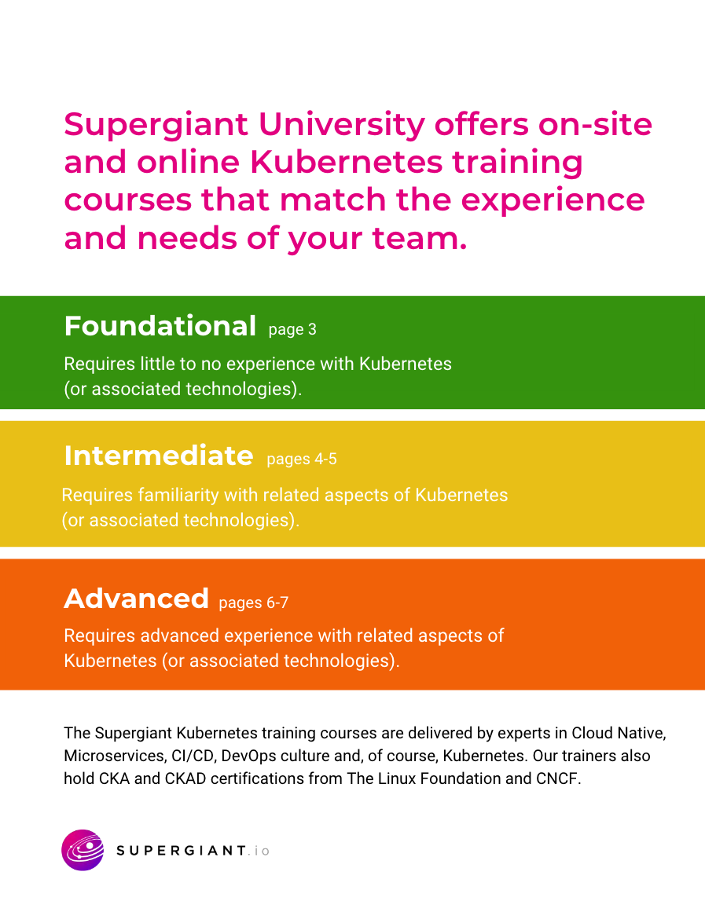
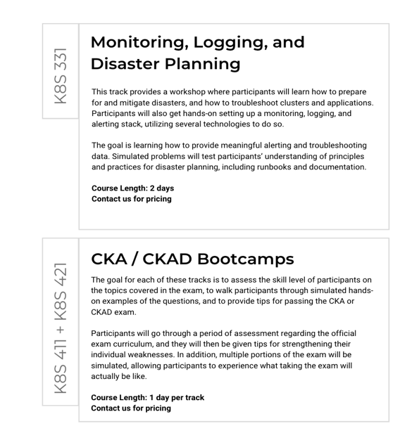
supergiant.io/training/
Notes:
Training (Paid): supergiant.io/training/
This process can be more difficult than it seems.
If you need help making experts, that’s our job.
We’re booth G1 on main aisle in purple sequined jackets.

Slide 49



See our slides at
supergiant.live/kubecon-eu-2019
Clarke Kubernetes Educator
clarke@supergiant.io
GitHub: TheKLARKEN
Twitter: @theklarken
Aaron Software Engineer
aaron@supergiant.io
GitHub: aaronteague
Slack: supergiantio.slack.com
Website: supergiant.io
Notes:
If you want to contact us, here’s our contact information. Questions? We’ll be out in the hallway after the talk if you have any more things you would like to talk about. If you don’t catch us there, our booth is at G1 on the main aisle, and we’re in the purple sequined jackets.

